Slide 1
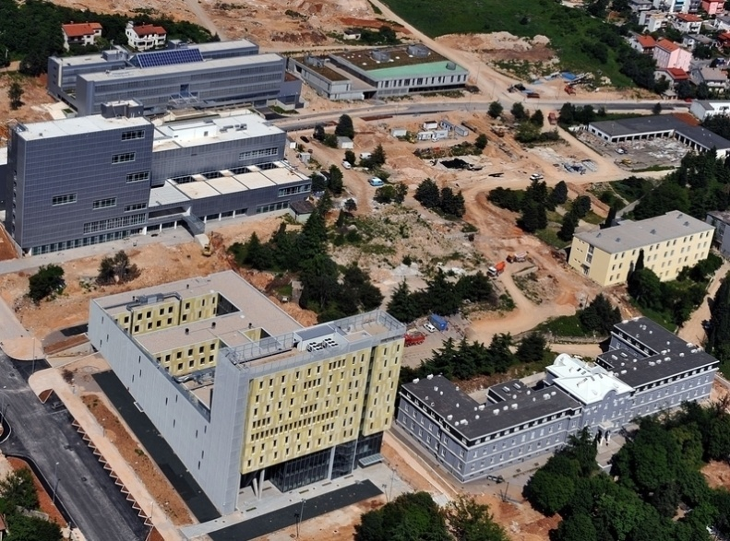
A Blended Learning Model for "Multimedia Systems" Course
Odjel za informatiku, Sveučilište u Rijeci
Omladinska 14, 51000 Rijeka, Hrvatska
Tel.: + 385 51 345 046 Fax: + 385 51 344 100
http://www.inf.uniri.hr
Natasa Hoic-Bozic,
Division of multimedia systems and e-learning

Slide 2

Content
“Multimedia Systems” e-course design and development
  Pedagogical approach to blended learning and learning activities
Technology and its efficiency in achieving student’s motivation
Results of evaluation
  Questionnaire results and student comments

Slide 3
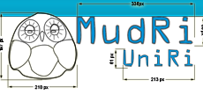
Introduction
Blended learning model realized as a combination of a self-paced learning, f2f classroom learning, and online learning supported by the Moodle LMS (MudRi)
“Multimedia systems” - the best e-course on the University of Rijeka in the academic year 2010/2011

Slide 4
MMS Background
the 3rd year of the undergraduate study of Computer Science at the University of Rijeka
2 hours of lectures and 2 hours of practical exercises per week
5 ECTS
Blended learning model
  Theoretical part prepared for online learning
  Practical exercises – in classrom

Slide 5
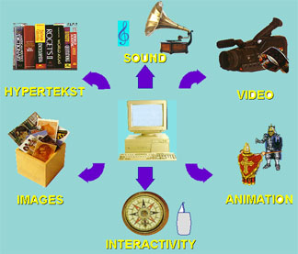
The overall objective
Students acquire fundamental knowledge about
  the digitalization of a single media (graphics, text, sound, animation, and video)
  integration of these media into a multimedia project

Slide 6
Learning outcomes
 | Expected learning outcomes
1. | define and compare the concepts of multimedia, hypermedia and hypertext
2. | outline and explain advantages and disadvantages of multimedia and hypermedia
3. | outline, describe and compare digital media elements: graphics, text, sound, animation, and video
4. | develop and design simple digital multimedia files: graphics, sound, animation, and video clips
5. | organize multimedia elements into multimedia presentation by WWW standards and according to the phases for multimedia project development

Slide 7


Theoretical topics
Introduction to multimedia
World Wide Web
Digital media elements
  Text and hypertext
  Graphics
  Sound
  Animation
  Video
Multimedia projects development

Slide 8
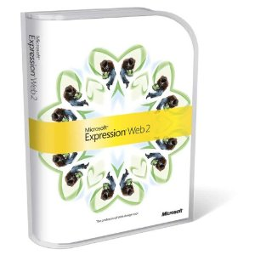

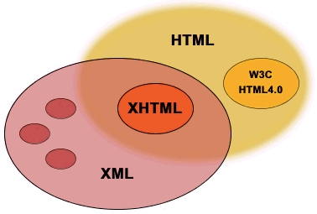






Exercises

Slide 9
Seminar - Flash presentation
Preparing original multimedia elements and organize it in Flash presentation
A personal biographical presentation of a student (multimedia ePortfolio) – prevents plagiarism
30 points (30% of the final course grade)
Notes:
The seminar was given 30 points (corresponds to 30% of the final course grade)

Slide 10
Sequential blended learning model
Combination of:
  f2f environment and an online environment
  Independent learning, online discussions, f2f practical work on computers, and problem-based learning
Activities are integrated chronologically in the course
The course schedule is published in the course calendar

Slide 11
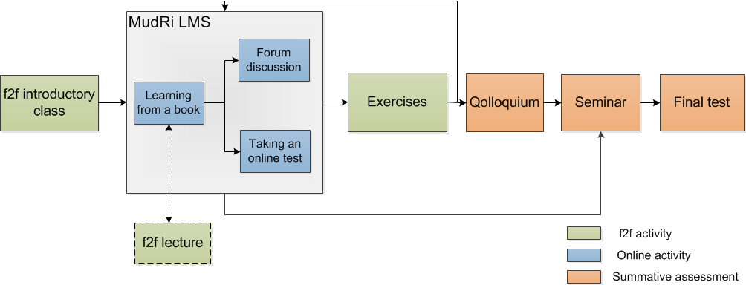
The order of the activities

Slide 12
Moodle LMS MudRi
Books with lessons
Tests for self-assessment and knowledge assessment
Home assignments that use advanced file submission
Forums (for announcements, discussions and Q&A forums)
Calendar
Grades report, survey, reports

Slide 13
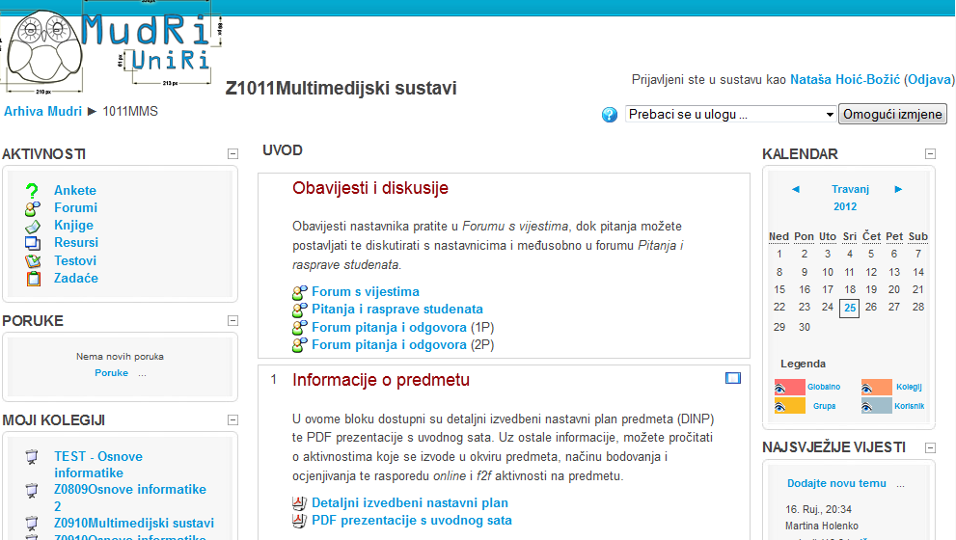
Thematic form with blocks/topics

Slide 14
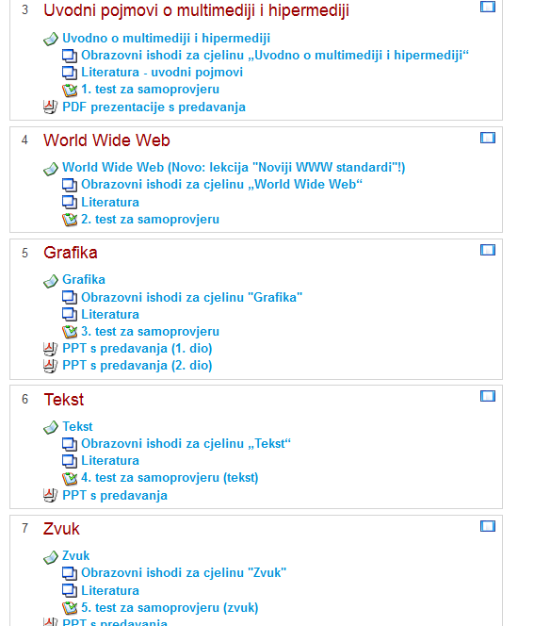
Blocks for the course topics
book with lectures
learning outcomes
literature and links
test for self-assessment
PPT presentation given at a f2f lecture

Slide 15
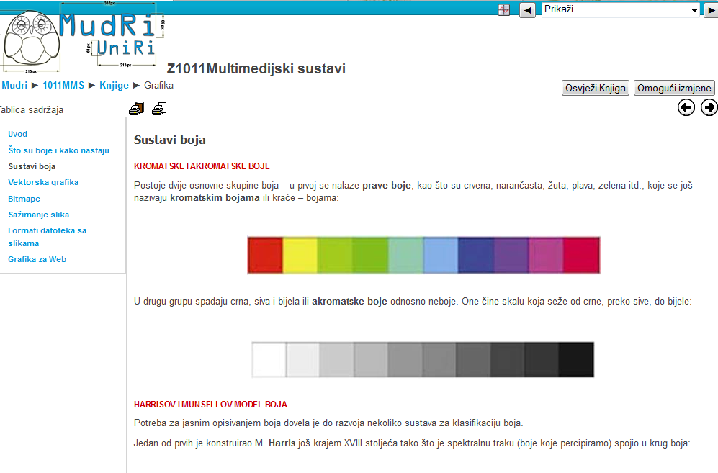

Slide 16
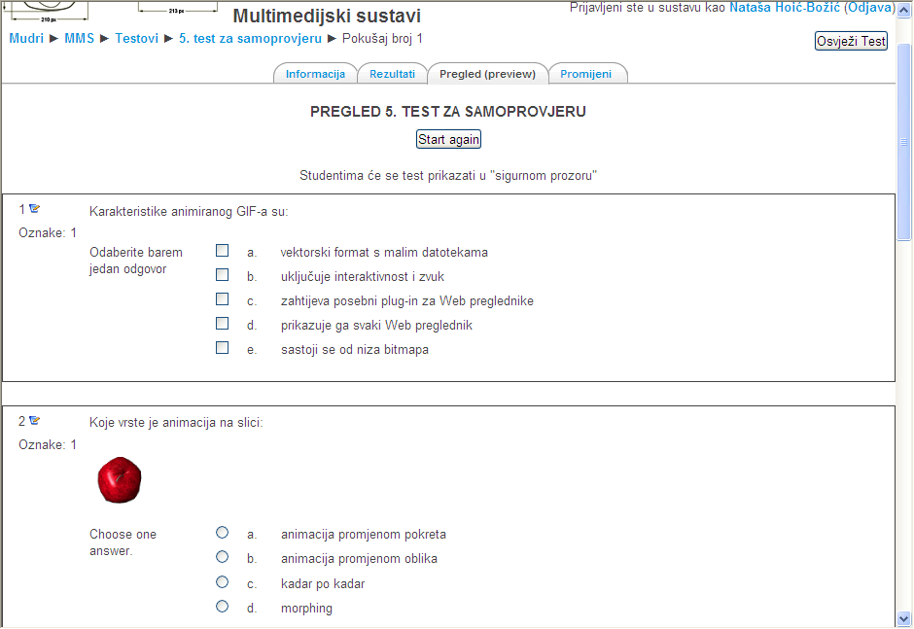

Slide 17
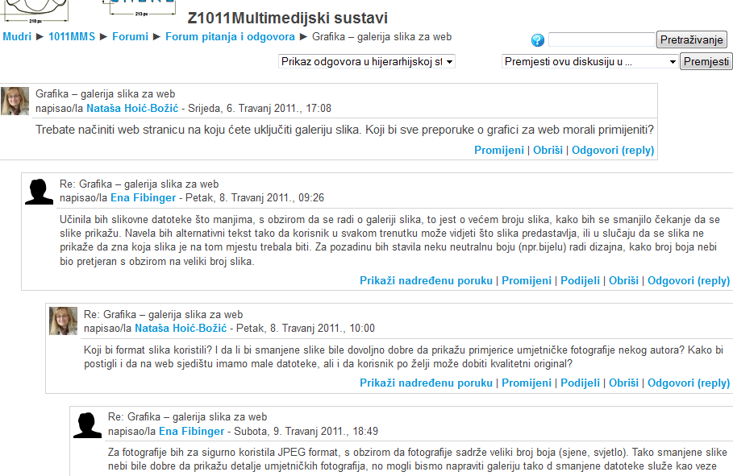
Question and answer (Q&A)

Slide 18
Efficiency of the used technology
Students of computer science - used to digital media and MudRi LMS
The used technology was not by its self new
Encouraging the students to learn continuously and independently
Develop communication skills in a written form (basic competencies of future IT specialists)

Slide 19
Grading
Points from the several mandatory elements:
Final grades:
Active participation in MudRi LMS | 10
Midterm test | 30
Seminar | 30
Final test | 30
 | 100
F- failed (1) | 0-39
E - satisfactory (2) D- satisfactory (2) | 40-49 50-59
C - good (3) | 60-69
B - very good (4) | 70-79
A - excellent (5) | 80-100
2010/2011 - 29 students: course pass rate 69%, avr. grade 3,31 (62% points)
2011/2012 - 62 students: course pass rate 90%, avr. grade 3,85 (74% points)

Slide 20
Academic results and evaluation
The evaluation in a form of an anonymous Moodle survey
expressed their opinion using the 1–5 Likert scale or chose the activity or tools for which they considered to be the most useful for learning
Students’comments
20/29 students in 2010-2011 academic year
23/62 students in 2010-2011 academic year

Slide 21
The most useful elements of the course (2010/2011)

Slide 22
The most useful elements of the course (2011/2012)

Slide 23
Students learned the most by: (2010/2011)

Slide 24
Students learned the most by: (2011/2012)

Slide 25
Students’ comments
“The course was very interesting and fun, which affects the overall impression of e-learning.”
“We could organise the time and a place of learning on our own.”
“The concept of the independent learning without a physical presence in the classroom and a possibility to chose the content which we want to learn.”
"I liked this way of “forcing” the students to constantly work through the semester, and not just before the colloquium."

Slide 26
Conclusion
The blended learning model was successful and the students were mostly satisfied with e-course
Combination of different activities and tools (f2f and online)
  every student can find more elements that are fit to him and achieve the learning outcomes for the course
Main problem: students do not prefer to communicate in discussion forum

Slide 27

Future plans
Web 2.0 tools are potentially more attractive to the students
Plan is combine the LMS with 2.0 tools available on the web – wiki, blog, ePortfolio,…
Introducing activities like writing individual diary and collaborative writing
Increasing students' motivation for participation in such activities which will help them to develop communication skills in a written form

Slide 28

Thank you for your attention!
www.inf.uniri.hr
Nataša Hoić-Božić
natasah@inf.uniri.hr

